Slide 1
Unified Modeling Language (UML)

Slide 2
Course objectives
After the course, student will:
Understand about UML concepts
Be able to read simple analysis/design UML diagrams
Can analysis overview of the system through symbols of UML such as: actor, events, use case scenario
Can analysis the activities/processing/ relationship of object in system through symbols

Slide 3
What is UML ?
UML - Unified Modeling Language
Standard & graphical language
Used for software as well as non software
UML is a language (notation) for modeling Object Oriented system
Used for making software blue print
specifying, visualizing, constructing, documenting the artifacts of software system

Slide 4
Why UML?
Graphical notation
A picture is worth a thousand words
Standard communication language
Provides multiple diagrams for capturing different Architectural Views
Promotes component reusability
UML is a standard language for visualizing, specifying, constructing, and documenting software systems

Slide 5
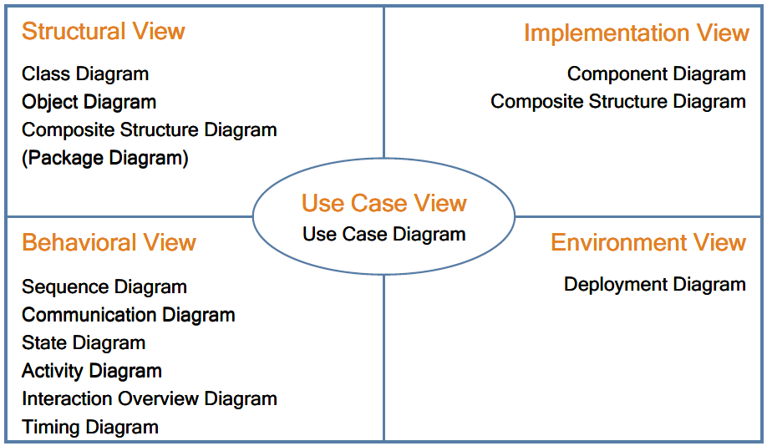
UML Architectural Views and Diagrams
UML defines 13 diagrams that describe 4+1 architectural views
4+1 architectural views model was proposed by Philippe Kruchten, IBM

Slide 6
UML Overview
Structural Things
Class, interface, collaboration,
use case, components, nodes
Class diagram
Object diagram
Component diagram
Deployment diagram
Behavior things
Interaction, State machine
Group things
Package
Structural Diagram
Annotation things
Note
Things
Diagram
Relationship
Use case diagram
Activity diagram
Interaction diagram
State machine diagram
Structural Relationship
Dependency, Aggregation,
Association, Generalization
Behavioral Diagram
Behavior Relationship
Communication, Includes,
Extends, Generalizes
Notes:
Structural things allow the user to describe relationships.
Behavioral describe how things work
Group things are used to define boundaries.
Annotational things are used to add notes to the diagrams
Structural relationships are used to tie the things together in the structural diagrams
Behavioral relationships are used in the behavioral diagram
For example, structural diagram used to describe the relationships between classes.
Behavioral diagrams can be used to describe the interaction between people (called actors in UML) and the things we refer as a use case, or how the actors use the system.
Bold ones are the most commonly used UML diagrams.

Slide 7
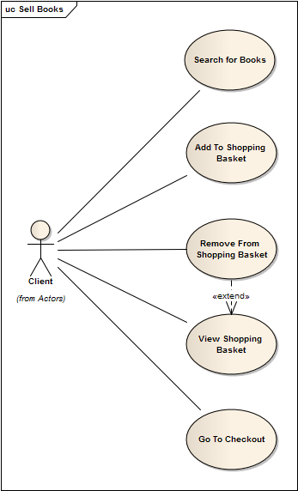
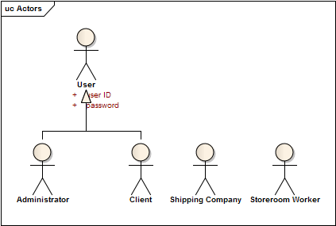
UML – Use case diagram
Describes the functionality provided by system
A Use Case represents a discrete unit of interaction between a user (human or machine) and the system.
Contains actors, use cases, and relationships
BookShop Sample: Actors + Sell Book Use Cases
Notes:
Use case digaram là để mô tả một cách tổng quát chức năng của hệ thống theo actor (một người hoặc một đối tượng nào mà có tương tác với hệ thống) và theo những gì mà actor đó muốn. Hay nói một cách đơn giản là use case diagram cho biết hệ thống có những chức năng, actor nào và chúng liên quan đến nhau như thế nào
A use case diagram, describing how the system is used.
A use case scenario (although technically it is not a diagram) is a verbal articulation of exception to the main behavior described by the primary use case.

Slide 8

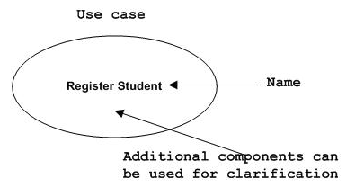
Use case diagram – Structural things
Actor:
Can be human user, internal applications, external application
Use case
High level functionalities of a system

Slide 9
Use Case Specification 1/6
Text description of use case functionality in the user language and terminology
No specific UML format
Describes WHAT and not HOW
Typically includes:
Objectives of the use case
How the use case is initiated
The flow of events (main flow, alternative flow)
How the use case finishes with a value to the actor
and more...
Notes:
A use case is described by a text description. It concentrates on the external behavior of the system and ignores how things are done inside the system. The text should be clear and consistent so that a customer can understand and validate it.
A use case describes the functionality as a whole, including possible alternatives, errors, and exceptions that can occur during the execution of the use case.
A high-level use case describes a process very briefly. High level use cases are defined during initial requirements definition and project scoping.
An expanded use case describes a process in more detail than a high-level one. It describes the step-by-step events.
During the requirements phase, important use cases can be written in expanded format, and detailed description of less important ones can be deferred to the development cycle in which they will be tackled.

Slide 10
Use Case Specification 2/6
Use case description serves as a ‘bridge’ between stakeholders of a system and the development team.
Systems analyst produce use
case diagram & use case
specification in consultation
with end users
Use Case
Diagram
Use Case
Specification
Notes:
Use case description serves as a ‘bridge’ between stakeholders of a system and the development team.
An instantiation of a use case is called a scenario, and it represents the actual usage of the system (a specific execution path through the system).
A use case can also be described through an activity diagram.

Slide 11
Use Case Specification 3/6
Flow of events
Use Case is an abstraction of behavior (set of sequences)
The behavior of the Use Case can be described by a “flow of events” - which spells out in detail what exactly the Use Case does
main flow: what happens and in what order when all is well
alternate flow(s): what happens and in what order when something goes wrong
exception flow: things don’t always go as planned. An exception is an error condition that is important enough to the application to capture
Notes:
A flow of events or pathway is a textual description embodying sequence of events with regards to the use case and is part of the use case specification.
Flow of events is understood by the customer. A detailed description is necessary so that one can better understand the complexity that might be involved in realising the use cases.
Flow of events describes how and when the use case starts and ends, when the use case interacts with the actors, and the information exchanged between an actor and the use case.
Flow of events is derived from a what perspective, NOT how perspective. Hence, specific information like: interface details and technical specifications should NOT be included in a use case description.
Basic Flow of Events (Happy Path): is the most common pathway. It usually depicts a perfect situation, in which nothing goes wrong. – You get to the ATM and successfully withdraw money
Alternate Flow of Events - is a pathway that is still considered a good pathway; it’s just not the most heavily travelled one (You get to the ATM but could not withdraw money due to insufficient funds in your account.)
Exception Flow of Events (Unhappy Pathway) – You get to the ATM machine but your valid pin number is not accepted.

Slide 12
Use Case Specification 4/6
Key components | Explanation
Name | Clear, unique name of the use case (verb, goal-driven)
Actors | Someone or something that interacts with the use case
Description | Brief overview of the use case, describing the main idea
Goal | What the actors achieve with this use case
Pre-condition | State(s) the system can be in before the use case starts
Trigger | Event that causes the use case to be initiated
Post-condition | State(s) the system can be in after the use case finishes
Normal flow | Typical (primary) processing path
Alternative flow | Alternative (secondary) processing path
Exception flow | When things go wrong at the system level
Others | Business rules, Assumption, Notes, etc.

Slide 13
Use Case Specification 5/6
Example
Make a seat reservation use case
Name | Make reservation
Actors | Passenger
Description | Allows a passenger to book a plane seat for a journey from the Website
Goal | Reserve a seat
Pre-condition | Main Webpage is displayed successfully
Trigger | User clicks on “Reserve seat” button on the main Webpage
Post-condition | A seat is booked Number of available seats is reduced

Slide 14
Use Case Specification 6/6
Example
Make a seat reservation use case
Normal flow | [User log in and reserve a seat successfully] 1. User logs in 2. User specifies a flight and travel details 3. User specifies passenger details 4. User specifies payment details 5. User confirms transaction
Alternative flow | [When no seat is available on the selected date] Show option to select another day Repeat steps in normal flow
Exception flow | [When a payment is failed] Notify error with the payment Give an option to re-enter payment details or other payment method
Notes:
Qualities of a Good Use Case
The following guidelines have proven useful in producing tight, easy-to-understand use cases in a variety of contexts:
Use active voice, and speak from the actor's perspective. For some reason, engineers and other technically inclined people tend to rely heavily on passive voice: "The connection is made," "The item is selected by the customer," and so forth. You should always express use cases in active voice. After all, you wouldn't expect to see a user manual written in passive voice, and there's a direct correlation between use cases and user manual text. (The most significant difference is that the latter is written in what's called the second-person imperative, with an unspoken "you," whereas use case text is written in the third person, in terms of specific actors and the system.)
Use present tense. Requirements are usually written in the future tense: "The system shall do this and that," "The throughput of the system shall meet the following parameters." Each sentence of a use case should appear in the present tense: "The Customer selects the item," "The system makes the connection." This includes the text for alternate courses. (For example, "If the Customer selects a different item, the system comes to a grinding halt.") Keeping all the text in a consistent form makes it easier for its readers to trace the different paths through the basic course and alternate courses.
Express your text in the form of "call and response." The basic form of your use case text should be "The [actor] does this" and "The system does that." The actor may do more than one thing consecutively, and the same holds true for the system, but the text should reflect the fact that the actor performs some action and the system responds accordingly. There shouldn't be any extraneous text.
Write your text in no more than three paragraphs. One of the guiding principles of object-oriented design is that a class should do a small number of things well, and nothing else. Why not adhere to this principle with use cases as well? A use case should address one functional requirement, or perhaps a very small set of requirements, and do it in a way that's obvious to anyone who reads it. Anything more than a few paragraphs, and you probably have a candidate for another use case. (See the section "Organizing Use Cases," later in the chapter, for a discussion of how to break up and organize use cases.) A sentence or two, however, is a signal that you don't have enough substance in your use case. Each use case should be a small, mobile unit that lends itself to possible reuse in other contexts.
Name your classes. There are two basic kinds of classes that lend themselves to inclusion in use case text: (a) those in the domain model (see the section "Domain-Level Class Diagrams" in Chapter 3) and (b) "boundary" classes, which include those windows, HTML pages, and so on that the actors use in interacting with the system. Down the line, it's going to be easier to design against text such as "The Customer changes one or more quantities on the Edit Contents of Shopping Cart page" and "The system creates an Account for the Customer" than against less-specific text (for example, "The Customer enters some values on an HTML page"). Be careful, though, to avoid including design details. You wouldn't talk about, say, the appearance of that HTML page or exactly what happens when the system creates an Account. The idea is to provide just enough detail for the designers to understand what's needed to address the basic requirements spelled out by the use cases.
Establish the initial context. You have to specify where the actor is, and what he or she is looking at, at the beginning of the use case. There are two ways to do this. The first way involves specifying the context as part of the first sentence: "The Accountant enters his or her user ID and password on the System Login window," for example. The second way involves defining a precondition: "The Accountant has brought up the System Login window." Doing this also makes it easier for someone to piece together the larger picture across a set of use cases.
Make sure that each use case produces at least one result of value to one or more actors, even if that result is negative. It's important to remember that a use case can't just end floating in space—something measurable has to happen. Of course, this is generally some positive result: "The actor is logged in to the system," "The system completes the actor's task by updating the database," "The system generates a report." A use case can end on an alternate course of action, though, so "The system locks the user out of the system and sends an email to the system administrator" is also a viable result, even though it's hardly a desirable one.
Be exhaustive in finding alternate courses of action. A lot of the interesting behavior associated with a system can be nicely captured within alternate courses—and it's a well-established principle that it's a lot cheaper to address this kind of behavior early in a project rather than later. A highly effective, if sometimes exhausting, way to root out alternate courses is to "challenge" every sentence of the basic course. In other words, ask repeatedly, "What can the actor do differently—or wrong—at this point?" or "What can go wrong internally at this point?" Remember two things while you're doing this. First, you don't need to account for generic failure conditions—network down, database inaccessible—within each use case; focus on those things that might happen in the specific context of the use case. Second, remember to take into account not only the novice/unsophisticated user but also the malicious user, the person who tries things he or she shouldn't just to see what might happen.
There are a couple of good methods for pointing to alternate courses from within the basic course. One surefire way to signal the presence of an alternate course involves using words such as validates, verifies, and ensures within the basic course. Each time one of these words appears, there's at least one associated alternate course, by definition, to account for the system's inability to validate, verify, or ensure the specified condition. For example, the basic course might say, "The system verifies that the credit card number that the Customer entered matches one of the numbers it has recorded for that Customer," while the corresponding alternate course might read, "If the system cannot match the entered credit card number to any of its stored values, it displays an error message and prompts the Customer to enter a different number." Another way to indicate the presence of an alternate course involves using labels for the alternate courses and then embedding those labels in the basic course. For example, an alternate course might have a label A1, and that label would appear in parentheses after the relevant statement(s) in the basic course.

Slide 15
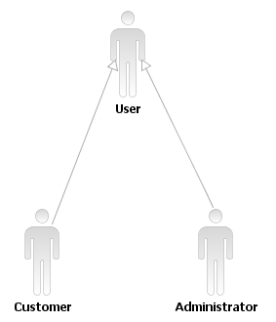
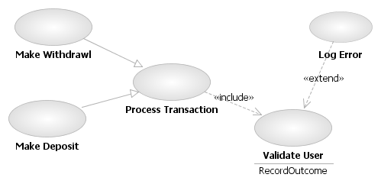
Use case diagram – Relationship
Actor Relationship: Generalization
Used to define overlapping roles between actors
Actor – Use case relationship
Association
Use case Relationship
Include
Extend
Generalization/Specification
Notes:
Actor relationship: generalization: tức là tổng quát hoá: như hình bên: khách hàng và người quản trị hê thống sẽ được tổng quát hoá = 1 actor là người sử dụng. Việc sử dụng relationship này rất hữu dụng khi bạn muốn định nghĩa những chức năng trùng nhau của actor, ví dụ: cả khách hàng và người quản trị hê thống đều phải login và có account/password

Slide 16
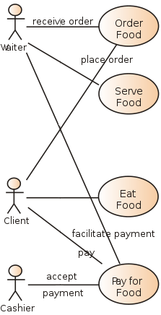
Use case diagram – Association Relationship
Association
Relationship between Actors & use cases
Actor is involved in interaction described by use case
If association line has Arrow head:
Indicate direction of invocation, primary actor
Indicate control flow (not data flow)

Slide 17
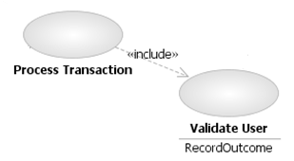
Use case diagram – Include Relationship
Include:
Directed Relationship between 2 use cases
Behavior of the included use case is inserted into the behavior of the including use case
Included use case
Including use case
Notes:
Use case relationship: include: use case đầu tiên sử dụng/ phụ thuộc vào kết quả của use case được bao gồm, ví dụ: việc thực hiện giao dịch (Process Transaction) tuỳ thuộc vào kết quả của việc kiểm định người sử dụng
(benefit: use-case duoc included thuong duoc dung chung cho nhieu use-case khac)

Slide 18
Use case diagram – Extend Relationship
Extends
Behavior of extension use case may be inserted in extended use case under some conditions
Extension use case :
Optional ,
Potentially not executed with the base use case,
Not required to achieve the base use case goal.
Extension use case/
Optional
Extended use case/Base use case
Notes:
Use case relationship: extend: cho biết hành vi của một use case được extend (mở rộng) theo một use case khác theo một điều kiện nào đó, ví dụ: việc kiểm định người sử dụng có thể được mở rộng ra một use case Log error (ghi lỗi) nếu account/password không đúng

Slide 19
Use case diagram – Generalization Relationship
Generalization/Specialization
Specialized use cases have common behaviors, requirements, constraints, assumptions
Commons are described once in general use case
Differences are described in specialized use case
Specialized use case
General use case
Notes:
Use case relationship: generalization/specialization: cho biết sẽ có một số use case cụ thể hơn sẽ kế thừa hoặc thêm vào use case đầu tiên, ví dụ: Make withdrawl và Make Deposit là hai use case cụ thể hơn của use case thực hiện giao dịch (Process Transaction)

Slide 20
Use case diagram
To draw use case diagram, identify
Functionalities to be presented as use case
Actors
Relationship among the use cases and actors
Good use case diagram
Name of use case is very important.
Give a name that can identify the functionality to be performed
Give suitable name for actor
Show relationships and dependencies clearly in diagram
Do not include all types of relationship.
Main purpose of use case diagram is to capture requirement
Use note when ever required to clarify some important points

Slide 21
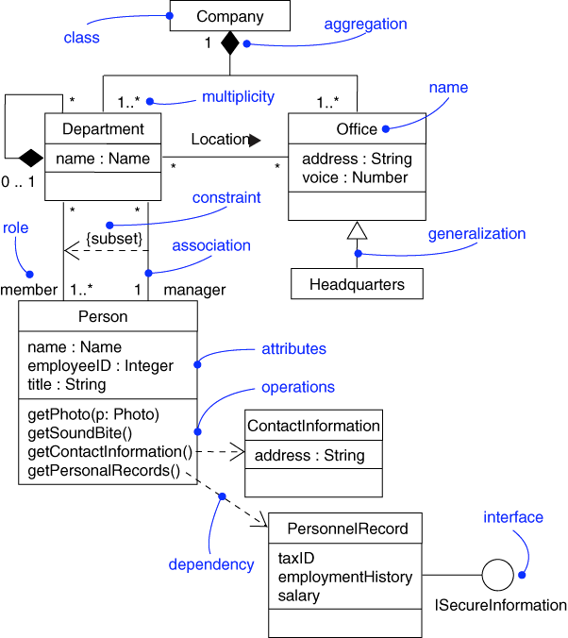
Class diagram
Describe the structure of a system
Show the system's classes, their attributes, and the relationships between the classes.
Purpose:
Analysis and design of the static view of an application
Show the collaboration among the element of a static view
Describe responsibilities of a system
Base for component and deployment diagrams

Slide 22
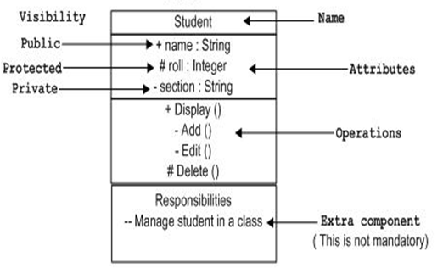
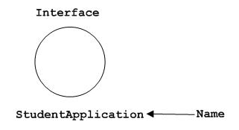
Class diagram – Structural Things
Class
Represent object, having properties and responsibilities
Interface
Used to describe functionalities without implementation
Just like a template
Class implement a template ➔ Implement the functionalities
Class

Slide 23
Class diagram Inheritance
Classes with a set of similar attributes and operations may be organized into a hierarchical relationship
Common attributes and operations are factored out and assigned to a broad superclass (generalization)
generalization is the “is-a” relationship
superclasses are ancestors, subclasses are descendants
A class can be iteratively refined into subclasses that inherit the attributes and operations of the superclass (specialization)

Slide 24
Class diagram OMT Inheritance Notation
Generalization
Superclass
Class
Attributes
Operations
Ball
Radius, Weight
Throw, Catch
Subclasses
Football
air pressure
pass, kick, hand-off
Baseball
liveness
hit, pitch, tag
Basketball
air pressure , dimples
shoot, dribble, pass
Specialization

Slide 25
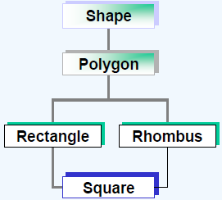
Class diagram Multiple & Multilevel Inheritance
Single inheritance: Inherit from only one super class
Multiple inheritance: a class have common characteristics with more than one super class
Multilevel inheritance :
Level of inheritance
hierarchy.
Notes:
Trong class hierachy, Shape is Root class, Square is Leaf class
Class hierachy has 4 levels

Slide 26
Class diagram Advantages of Inheritance
Development model closer to real life object model with hierarchical relationships
Reusability – reuse public methods of base class
Extensibility – Extend the base class
Data hiding – base class keeps some data private ➔ derive class cannot change it
Rapid prototyping
Notes:
All benefit apply to design, development and maintenance

Slide 27
Class diagram Associations
Associations model Class relationships.
Associations should be named where appropriate. Usual to use verbs from the problem domain.
Roles played by classes may also be named.
Associations have a cardinality.
Rules from programming about sensible names apply.

Slide 28
Class diagram Abstract class 1/2
Class that contains one or more abstract methods
Abstract method: Method that has only declaration but no implementation.
Classes that extend abstract class make them concrete by implementing those abstract methods
Notes:
Abstract class : class do not represent anything concrete (cụ thể).
Class as “holder” for the shared/inherited attributes and behavior for derived classes.

Slide 29
Class diagram Abstract class 2/2
It is impossible to instantiate an object from abstract class
class animal
{ protected: int speed;
char color[20];
public:
pure virtual void init();
float run(int distance){
float time = round(((float) distance)/speed,2);
cout<<“It runs "<<distance<<“miles in “<<time<<“hour.” <<endl;
return time; }
pure virtual void show() ;
};
animal *p = new animal();
animal p;
It is possible to create a pointer to abstract class
animal *p;
Notes:
Can kiem tra lai cach declare abstract class, abstract method trong C++

Slide 30
Class diagram Polymorphism
Polymorphism = multiple forms/many shape
By Definition:
1. The ability of objects to have different operations from the same interface.
2. The ability of different objects to respond in their own unique way to the same message
Implemented by:
Overloading
function overloading
operator overloading
Override
Notes:
Bổ xung hình vẽ

Slide 31
Class diagram Polymorphism - Overloading
To assign an operator, identifier or literal more than one meaning, depending upon the data types associated with it at any given time during program execution.
Two or more method with the same name, different signature
Example:
void display (int iX)
void display (float fY)
void display (char[] chC)
void display (char[] chC, int offset, int numchar)

Slide 32
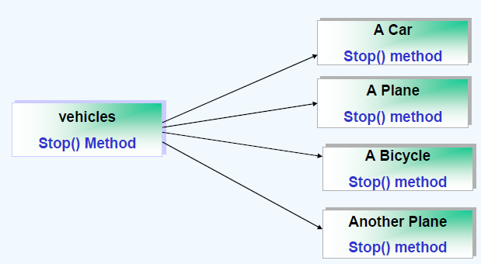
Class diagram Polymorphism - Overriding
Process of defining/re-defining the methods in the derived class
Methods have same name/same signature

Slide 33
Class diagram Polymorphism Example 1/2
class animal
{
protected: int speed;
char color[20];
public:
virtual void init(){}
float run(int distance)
{
float time = round(((float) distance)/speed,2);
cout<<“It runs "<<distance<<“miles in “<<time<<“hour.” <<endl;
return time;
}
virtual void show() {}
};

Slide 34
Class diagram Polymorphism Example 2/2
class dog: public animal
{
public:
void init()
{
speed = 40;
strcpy(color, “Black”);
}
void show()
{
cout<<"Speed of a dog is "<<speed<< “miles/hour”<<endl;
cout<<"Color of a dog is "<<color<<endl;
}
};
class tiger: public animal
{
public:
void init()
{
speed = 90;
strcpy(color, “Red”);
}
void show()
{
cout<<"Speed of a tiger is "<<speed<<“miles/hour”<<endl;
cout<<"Color of a tiger is "<<color<<endl;
}
};

Slide 35
Class diagram - Relationship
Instance level relationship
Association
Aggregation
Composition
Class level relationship
Generalization
Realization
General relationship
Dependency

Slide 36

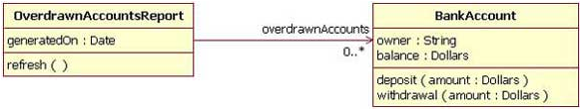
Class diagram – Association Relationship
Association name
Multiplicity
Visibility
Role name
Represents the static relationship shared among the objects of two classes
Bi-directional:
both classes are aware of each other and their relationship
Uni-directional:
two classes are related, but only one class knows that the relationship exists

Slide 37
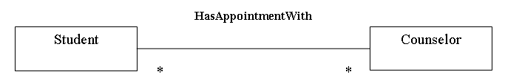
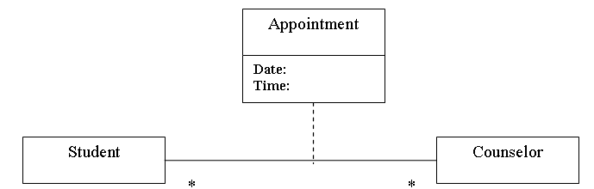
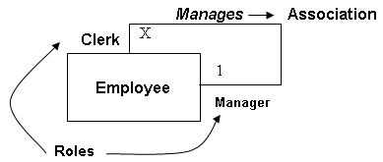
Class diagram – Association Relationship
Association class
Reflexive association

Slide 38

Class diagram – Aggregation Relationship
Container class
Contained class
A type of association
Aggregation – “Has a” relationship
One class is collection or container of another classes
Contained classes do not have strong life cycle dependency on the container
If container is destroyed, contents are not.

Slide 39

Class diagram – Composition Relationship
Container class
Contained class
Strong type of association
Composition - “owns a” relationship
One class is the collection of another class
Strong life cycle dependency between container objects and contained objects
If container is destroyed, normally every instance that it contains is also destroyed
Notes:
Car “has a” carburetor: composition: một động cơ có một bộ chế hoà khí. Xe mà lao xuống sông thì bộ chế hoà khí cũng tiêu luôn.

Slide 40
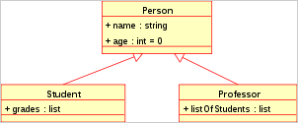
Class diagram – Generalization Relationship
Generalization – Inheritance or “Is a” relationship -
“Professor” is a subtype of Person
“Person” is a generalization of “Student” and “Professor”
Supertype – Super class
Subtype – Sub class

Slide 41

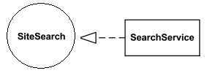
Class diagram – Other Relationship
Dependency Relationship
Weak relationship
One class depend on the other because it use the other
Dependency exists if a class is a parameter variable of a method of another class
Realization Relationship
One model implement/realize the other model
Ex: One class implement the interface defined by other class

Slide 42
Create Good Class Diagram
Name of class, name of diagram should be meaningful to describe the aspect of the system
Element and relationship should be identified in advance
Responsibility (attributes and methods) should be identified in advance
For a class: Minimum of properties should be specified.
Unnecessary properties make class diagram look complicated
Use note when ever required
Diagram may be drawn on plain paper and rework many times to make it correct

Slide 43
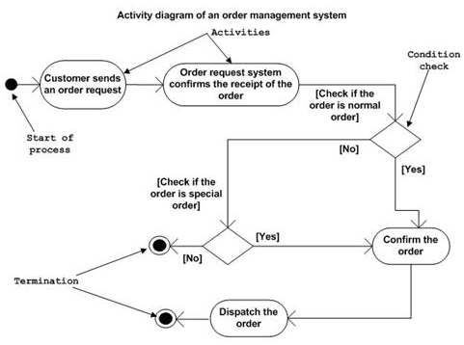
Activity diagram (1)
Flow chart to represent the flow from one activity to another activity
Purpose
Draw the activity flow of a system.
Describe the sequence from one activity to another.
Describe the parallel, branched and concurrent flow of the system.

Slide 44
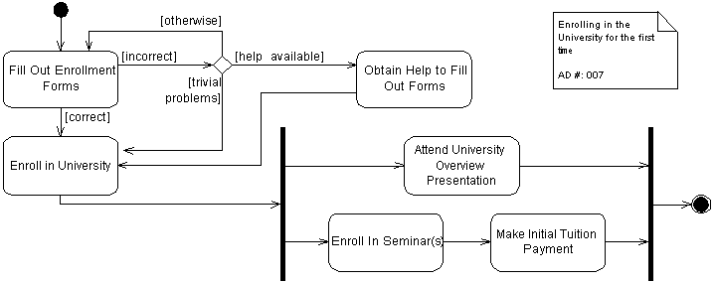
Activity diagram (2)
Fork

Slide 45
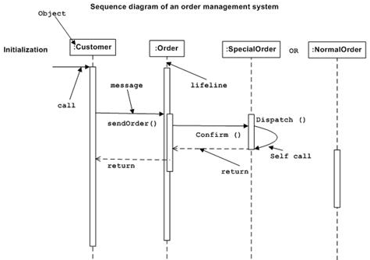
Interaction Diagram - Sequence diagram
Emphasis on time sequence of messages

Slide 46
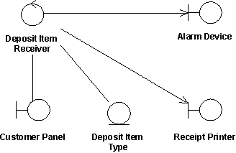
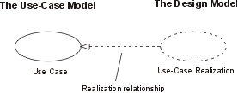
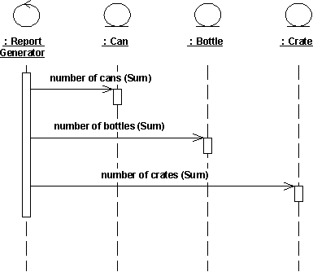
Use case realization
Use-case realization represents how a use case will be implemented in terms of collaborating objects
For each use case in the use-case model, there can be a use-case realization in the analysis/design model with a realization relationship to the use case
It may include:
A textual description (a document),
One or more class diagrams of participating classes and subsystems.
One or more Interaction diagrams (communication and sequence diagrams)

Slide 47
Use case realization Example
Class diagram – Analysis stereotype
At analysis stage
Boundary class-
Handle the communication between actors and system internal components
Entity class
Model for information handled by system and behavior associated with information
Control class
Handle the flow of control for a use case

Slide 48
Resources & references
Resources
http://en.wikipedia.org/wiki/Unified_Modeling_Language
Technical CD in Rational Rose software
EAExample.eap (EA 8.0)
Recommended readings
The unified modeling language reference manual
UML Tools:
Enterprise Architect (EA - http://www.sparxsystems.com.au/)
Visio
Rational Rose

Slide 49
Thank you
Question & Answer

